Slide 1
Definition
Most signals we want to process are analog
i.e.: they are continuous and can take an inifinity of values
What is ADC ?
Types of ADCs
HC11 & ADC
x(t)
t

Slide 2
Definition
Digital systems require discrete digital data
ADC converts an analog information into a digital information
What is ADC ?
Types of ADCs
HC11 & ADC
Analog
?
Digital
Digital System

Slide 3

Examples of use
Voltmeter
What is ADC ?
Types of ADCs
ΔV
7.77 V
HC11 & ADC
Cell phone (microphone)
Wave
Voice

Slide 4
Conversion process
3 steps:
Sampling
Quantification
Coding
These operations are all performed in a same element: the A to D Converter
What is ADC ?
Types of ADCs
HC11 & ADC

Slide 5
Conversion process: Sampling
Digital system works with discrete states
The signal is only defined at determined times
The sampling times are proportional to the sampling period (T_{s})
What is ADC ?
Types of ADCs
HC11 & ADC
x(t)
T_{s}
x_{s}(t)
x(t)
x_{s}(t=k*T_{s})
T_{s}
t

Slide 6
Conversion process: Quantification
The signal can only take determined values
Belonging to a range of conversion (ΔV_{r})
Based on number of bit combinations that the converter can output
Number of possible states:
N=2^{n} where n is number of bits
Resolution: Q= ΔV_{r}/N
What is ADC ?
Types of ADCs
HC11 & ADC
x_{s}(t)
x_{q}(t)
Q
ΔVr
t
T_{s}

Slide 7
Conversion process: Coding
Assigning a unique digital word to each sample
Matching the digital word to the input signal
What is ADC ?
Types of ADCs
HC11 & ADC
x_{q}(t)
N-1
N-2
Q
ΔVr
2
1
0
t
T_{s}

Slide 8
Accuracy
The accuracy of an ADC can be improved by increasing:
The sampling rate (T_{s})
The resolution (Q)
What is ADC ?
Types of ADCs
HC11 & ADC

Slide 9
Types of ADCs
What is ADC ?
Flash ADC
Sigma-delta ADC
Dual slope converter
Successive approximation converter
Types of ADCs
HC11 & ADC

Slide 10
Successive-approximation ADC (SAR ADC)
The following sub-circuits make up the SAR ADC:
Sample and Hold Circuitry (SHA)
Digital-to-Analog converter circuit (DAC)
Analog voltage comparator (COMPARATOR)
Successive approximation register circuit (SAR)
Other aspects of SAR ADC are:
VIn: Input Voltage
VRef: Reference Voltage
EOC: End of conversion

Slide 11
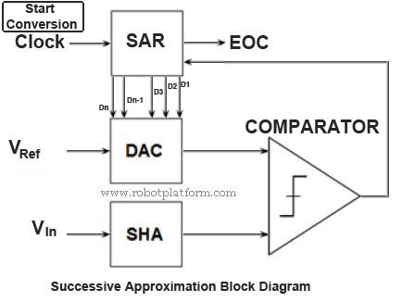

Slide 12
working
The working principle of SAR ADC is as follows
Sample and Hold circuit is used to acquire and hold input voltage (VIn) from transducer circuit to ensure that the voltage remains constant during conversion. DAC supplies an analog input voltage (VRef) to Comparator. Comparator compares the input from DAC and SHA and the result is stored in SAR. SAR provides DAC with appropriate digital code so that DAC outputs necessary analog voltage to Comparator. SAR also holds the result from comparator in its register. Once all the comparison is completed, the resulting digital equivalent of the analog signal is output and is end of the conversion (EOC).

Slide 13
The successive approximation register counts by changing the bits from MSB to LSB according to input. The detailed operation is shown below.

Slide 14
Operation of 3 bit Successive Approximation ADC
The output of SAR is converted to analog out by the DAC and this analog output is compared with the input analog sampled value in the Opamp comparator. This Opamp provides an high or low clock pulse based on the difference through the logic circuit. In very first case the 3 bit SAR enables its MSB bit as high i.e. ‘1’ and the result will be “100”. This digital output is converted to analog value and compared with input sampled voltage (V_{in}). If the deference is positive i.e. if the sampled input is high then the SAR enables the next bit from MSB and result will be “110”. Now if the output is negative i.e. if the input sampled voltage is less than the SAR resets the last set bit and sets the next bit and resultant output in this case will be “101” which will definitely approximately equal to the input analog value

Slide 15
Then the next bit is set to 1 and similar binary search is done until all the bits in SAR are tested till LSB (least significant bit). The resulting code in SAR is the digital output of the analog input.

Slide 16
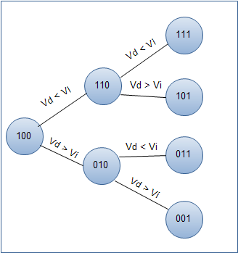
Flow chart for SAR

Slide 17
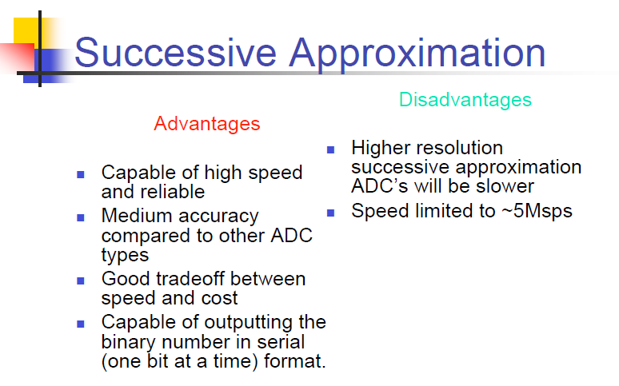

Slide 18
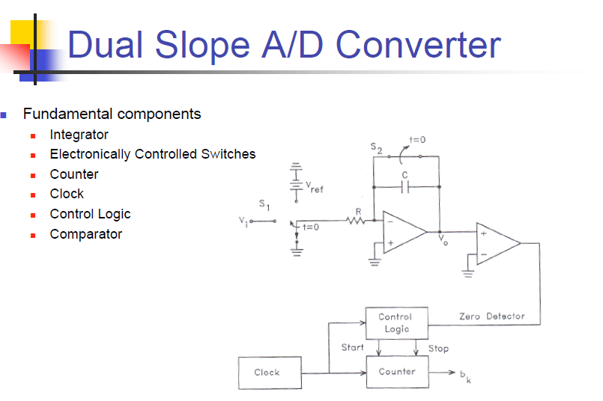

Slide 19
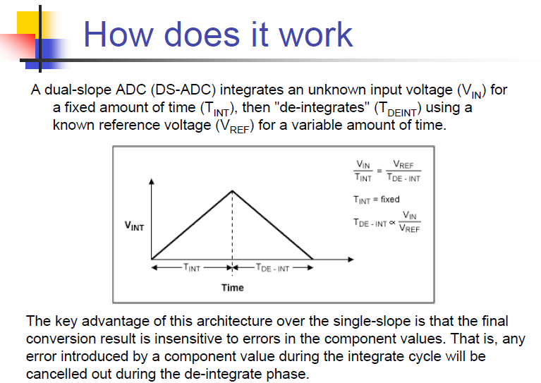

Slide 20
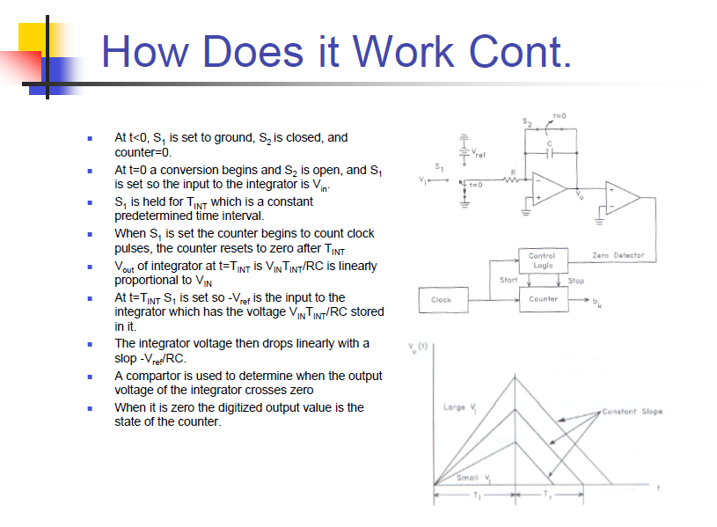

Slide 21
